Slide 1

THIRD TERM PROJECT PRESENTATION
BY PETER, MARION AND KATIE!
PRESENTING:

Slide 2
THE ORIGIN OF LEAN
In 2013, Leonardo de Moura created the Lean Project at Microsoft Research.
Lean 4 is the newest version, however we have worked with Lean 3.
Lean programming was Japanese industry concept adopted by the U.S. during the 1980s.
It has grasped the attention of Tomas Hales, who is using Lean for his project ‘Formal Abstracts’ and Kevin Buzzard regarding the ‘Xena Project’

Slide 3
HOW DOES LEAN WORK?
As written in the paper ‘ Programming in Lean’ by Jeremy Avigad, Leonardo de Moura and Jared Roesch: “a program in Lean is simply an expression whose value is determined compositionally from the values of the other expressions it refers to, independent of any sort of ambient state of computation.”
Common commands used in Lean are:
Import
Open nat
Begin, end
Have

Slide 4
To show you LEAN in action, let’s take a statement that all of you know how to prove
and prove it using only LEAN:

Slide 5
WTP: There are infinitely many primes
In case you’ve forgotten, here’s the proof of this statement mathematically:
Statement: ∀ N ∈ ℕ, ∃ p ∈ ℕ such that p ≥ N and p is prime
Let M := N! + 1 and let p be the smallest prime factor of M
Since p is a factor, p divides M
Suppose for contradiction that p ≤ N, then we have p divides N!
Since p divides N! + 1 and N! , we have p divides 1
This is a contradiction.
So p ≥ N.
Therefore there are infinitely many primes.

Slide 6
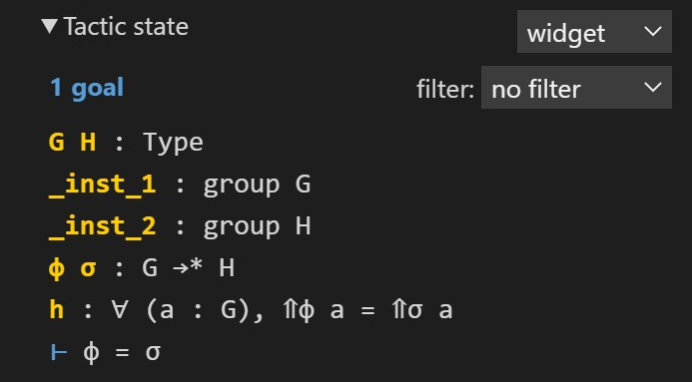
ASSUMPTIONS AND TACTICS
how lean looks:
From there, carry out steps in the proof by applying pre-defined methods known as tactics
Tactics are themselves Lean expressions of a special tactic type
An example: contradiction. In LEAN there is a tactic called by_contra
Once you have written the statement you wish to prove, LEAN will extract what it can
The goal is marked with the turnstile symbol
assumptions
goal
The three most common tactics we will be using are:
2. HAVE
have h : t := p, where p is of type t, adds the expression h : t to p, the current target.
have h : t adds the expression h : t to the current goal and opens a new subgoal with goal t
3. EXACT
Often used at the end of the proof
If a hypothesis h matches the goal, exact h will close the goal
INTRO
Used to separate out your assumptions
Often one of the first tactics you use

Slide 7
Now, over to our code:

Slide 8
THE FUTURE OF LEAN
Lean is a programming language that can help mathematicians achieve tremendous accomplishments in analysis, algebra and many other theorems
It is also still growing
Who knows, what if LEAN solve your problem sheets for you?

Slide 9
THE XENA PROJECT
Prof. Kevin Buzzard is one of the leading mathematicians involved in LEAN
He also runs the Xena Project
For those interested in LEAN, we recommend:
The natural numbers game!
https://www.ma.imperial.ac.uk/~buzzard/xena/
2. Join the Xena Project discord server
https://discord.gg/Q5jNska9

Slide 10
THANKS FOR LISTENING ☺

